Slide 1
An Options Data Acquisition Pipeline
Mark Streer
17 Dec 2021
METIS (DS/ML)
Notes:
Hi everyone, good morning. I’m going to jump right into introducing my project, a storage pipeline for stock options data.

Slide 2
Why Options?
Option
Symbol = NVDA_021822C320
Expiry Date = Feb 18th, 2022
Contract = Call
Strike Price = $320
Price = $11.97
Stock
Symbol = NVDA
Price = $303.69
Cost to control 100 shares:
$30,369 >>> $1,197
Notes:
So you’ve all heard of the stock market right? Buy low, sell high, FAANG, Gamestop, wallstreetbets, etc.
If I buy Nvidia stock, the stock is mine until I sell it: tomorrow, or next year, or ten years from now, or 100.
Options are contracts to buy and sell stocks. In the example shown, the buyer has the option to buy 100 shares of NVDA at $320 per share at some point before Feb 18th. It's useless right now: you can buy them at $300 on the open market. If NVDA rose to $350 tomorrow, however, it would be great: you could buy 100 shares for $320 each, sell them for $350 each, for 30x100=$3000 profit. But if it never rises above $320, the option will expire worthless.
CUT
What makes options really great are their leverage [CLICK]. We could have bought and sold 100 shares, but we’d need 30 grand principal.
With options, we can get some of that exposure for a just over $1000, as opposed to over 30 grand.

Slide 3
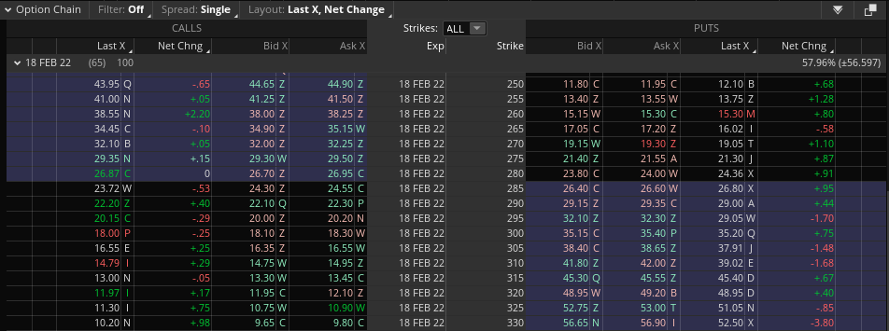
Why Options?
NVDA products available:
Stock: 1 Options: 1,621
Notes:
Here’s where I got that price info I just showed you. This is a partial view of the options chain the 18th of February.
[CLICK] We look up our expiry date and strike price, [CLICK] and check the left (because it’s a bullish ‘call’ contract).
There are 17 additional tables for the other expiry dates: from today (17 Dec) to 19 Jan 2024, each with their own chain.
[CLICK] In total, there are 1,621 NVDA options available from this broker, TD Ameritrade. Far richer data than a simple price history.
Share price histories of most stocks are offered free of charge by most brokerage, and even Yahoo Finance. However, historical options data are held close to the chest; I’ve never been able to find inexpensive sources online, much less for free. My hope is to keep an automated pipeline going for a few months or years, so I can get my own ‘historical data’ on which to train deep learning models.

Slide 4
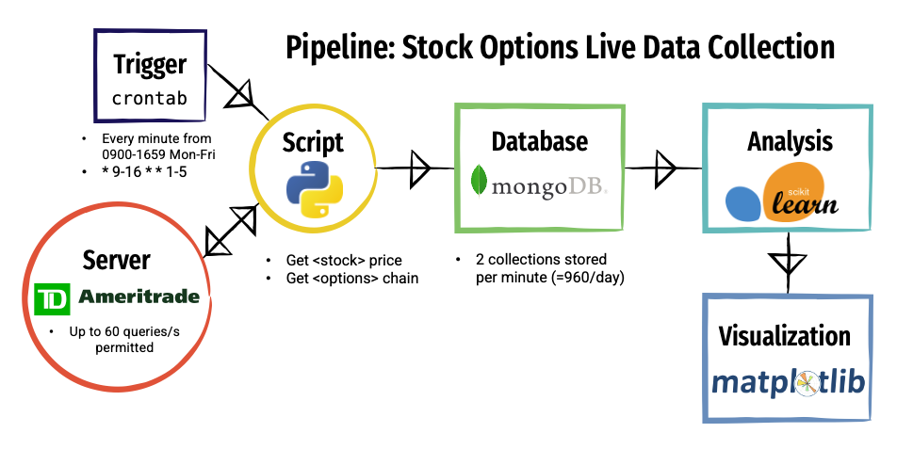

Data Storage & Analysis Pipeline
Live
Offline
Notes:
Here’s my data storage and analysis pipeline. A Python script acquires the raw data from the TD Ameritrade Get Options Chain API, which they allow you to query up to 60 times a second. The script then stores the two json responses in a mongo database. The script is triggered locally by means of a cronjob; in fact, everything is run locally on my M1 Mac Mini.
I wish I could show you some analysis results for the options chains I’m collecting, but I’ve just started, and don’t have enough data to feed time series or deep learning models just yet. For now, I’m going to show you a visualization of an option chain I’ve loaded into Streamlit. But first…

Slide 5
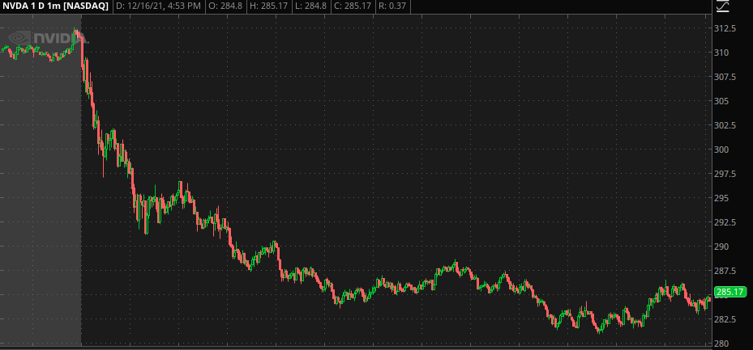
Price History
Notes:
Let me show you NVDA’s price history from yesterday, from 830am to 4pm. Big tech was strongly negative for most of the day, and NVDA was no exception; starting at over $310 per share, and closing at $285, nearly a ~7% drop. Fortunately, that makes the movement of derivatives like options even easier to see.
Now, the visualizations you’re about to see were done in matplotlib.

Slide 6
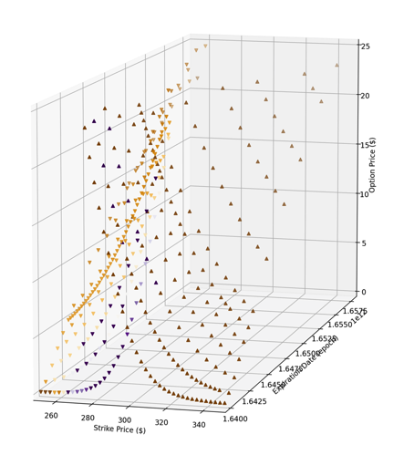
10:00
Notes:
So there’s a lot to take in here. First, the simple parts: the vertical axis is the option price: how much each contract/point goes for on the market.
Every up arrow is a call option, which increase in value when NVDA goes up; every down arrow is a put option, which decrease in value when it goes down. They kind of look like two hockey sticks, right? Each pair of crossed hockey sticks is the options chain for that expiration date. Tellingly, they cross at the stock’s current price: at 10am, it was just over $300.
The depth axis is the expiration date, so imagine you’re looking into the future as you look into the screen. Long-dated options are more expensive, because there’s more time for the stock to rise or fall.
In terms of the color scheme, red indicates losses, while green indicates gain, and blue the strongest gains. Given the 3% drop, all of the call, up-arrows are in the red, while the puts are flush blue.

Slide 7
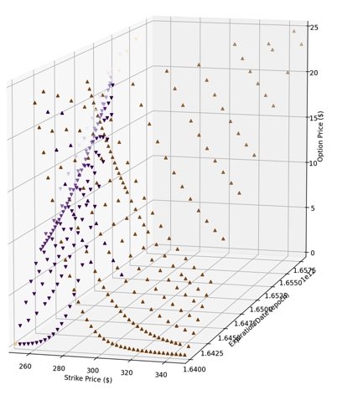
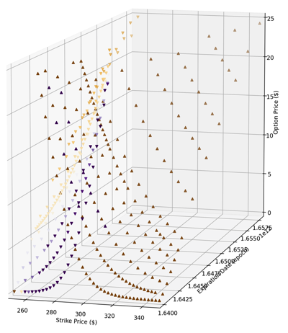
14:00
Notes:
Seven percentage points later, it’s clear the bears have won the day. The hockey sticks intersect at $285, which is about where it closed.
I’ve put these visualizations online: I’ll toss the link in the chat if you want to play around with it. But for me, the real value of the project was the automated data acquisition.

Slide 8
Use Cases
#1: Price prediction
Linear regression
Time series (ARIMA)
#2: Decision support
Binomial (sell | don’t sell)
Multiclass (buy | sell | hold | … )
#3: Deep learning
Seq2seq models
Notes:
Options prices are often valuable indicators of expected future price movements, which feed into strategy.
I’d probably use a time series or regression problem to estimate a future price, or expected rates of appreciation.
I’d use a classification algorithm for decisions on specific plays: for example, given options movement on Monday and Tuesday, should I buy contract X? or sell contract Y?
Both classes of problems could be hyper-driven by deep learning algorithms.

Slide 9
Thanks!
Notes:
That’s all I have for today. I wanted to close by saying how much I enjoyed learning with and from you all these last 14 weeks, in project groups and pairs.
Lectures and tutorials are one thing, but seeing how such smart and creative people approach the same coding problems and project prompts differently was really educational, and motivated me to try harder than I could have alone. So, thanks for listening, and thanks for being a big and influential part of my life this fall. I’m sure we’ll see one another again.

Slide 10
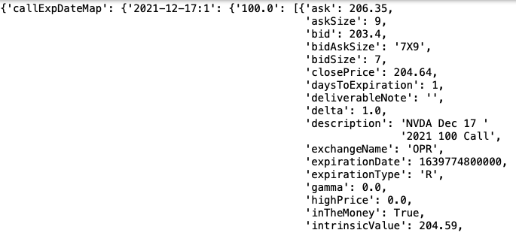
Reference: API Responses
callPut
expiry
strike
48 fields
Notes:
Here’s a screenshot of a typical response from the TD Ameritrade API.
Note the nested structure, with the contract type first, then all expiry dates, then all strike prices at all expiry dates. For one query, we get:
2 contract types (call or put),
21 expiry dates, from today until January 2024, and
216 strike prices, from $70 to $600.
Not every strike is available for every expiry, so there are fewer choices than 9,396. But very rich data for a single snapshot.
Each of which has each of these attributes as columns, including ‘mark’ price, the current market price, which we’ll use in visualization.

Slide 11
11:00
Notes:
One hour later, the trend persists. The calls extend their losses and get even redder, while the $310 puts have gained so much they’re off the screen.

